Slide 1
Lab: Apache CouchDB Work on Project 2 In this project, we will build a NoSQL Document-Oriented database using CouchDB via the Fauxton UI. This database will be used to provide content to a website app, which will display customer invoices of an online retailer and the items on the invoices. The data is modified version of data from Machine learning website here. For the rest of the section follow the instructions below. There is an Excel file labeled Project2Data on Moodle. Use the data in the file to create the following records in the subsequent steps.
Notes:
When CouchDB needs to update a view with new data, it will update all views in a design document at the same time, as an optimization.
If you change anything inside the design document views space (even changing whitespace or comments in your Javascript), CouchDB will discard the old index and rebuild the view from scratch.
Every update in a database must pass all validate_doc_update() functions from all design documents in the database.
admin
root

Slide 2
Apache CouchDB Project Code for Creating a Database and Documents using Fauxton
Install Apache CouchDB and Fauxton. Click here.
Download the file needed for this project from Moodle. Then, open CouchDB via the Fauxton UI. To do so, go to “All programs” (or Applications) on your device, locate Apache CouchDB Fauxton, and click the Fauxton link.
Sign in with your user id and password (created during installation).
Create a schemaless database by clicking Create Database from the top right of the screen, name it jenkins_retail, and click the Create button).
Notes:
admin
root

Slide 3
Apache CouchDB Project Code for Creating a Database and Documents using Fauxton
5. In the Jenkins_retail database, insert all documents from the .cvs file into the database but with the following properties. (For each, click the Create Document button from the top right of the screen. Add a comma after the id and quote symbol. Then, add the data for that record. Click the Create Document button).
Create all the records with columns StockCode, Description, Quantity, Price, CustomerID and Country (that means you should NOT include Invoice and InvoiceDate in your columns). Notice that some of the rows do not have a value for the CustomerID column. When you enter the data for these rows, do NOT enter a CustomerID field or value. (Remember, in a NoSQL database different records can have different columns.)
Create another column “Demand” but ONLY for records with Quantity equal to or more than 12. In the column, put “Moderate” (if the quantity is between 12 to 20, inclusive of 12 and 20) or “High” (if the quantity is more than 20).
Notes:
admin
root

Slide 4
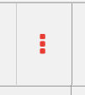
Apache CouchDB Project Code for Searching with the Map Function
6. To create a view, click the button and click New View.
Give the view a name (e.g., jenkinsview) in the _design/ box. From the Map Function area of the view, notice that the view will return the document id and a “1”. Click the Create Document and then Build index button. View the results of the view run.
7. Edit the view to display the document id and a literal 4. To edit the view, click the Wrench icon and choose Edit. From the Map Function area of the view, type the following and click Save Document and then Build Index button. The function will return (emit) the document id (record id) and the literal “4”:
function (doc) {
emit(doc._id, 4);}
Notes:
admin
root

Slide 5
Apache CouchDB Project Code for Searching with the Map Function
8. Suppose we want the document name to be the key and the document itself to be the value. Edit the view to display the document name and document id instead of the literal 4. Type the following, and the function will emit the document id, key, and value:
function (doc) {
emit(doc._name, doc );}
Notice that the key returns a “null” value for each document. Let’s address that in the next steps.
Notes:
admin
root

Slide 6
Apache CouchDB Project Code for Searching with the Map Function
9. If you type the following and save your work, the function will emit the document name and the contents of the document:
function (doc) {
emit(doc._name,doc.content);}
10. Notice that the output results are null for the name. That is because the key is actually “name” and not “_name”. Change it below, save, and rerun:
function (doc) {
emit(doc.name,doc.content);}

Slide 7
Apache CouchDB Project Code for Searching with the Reduce Function
11. Edit the view and replace the map function with this, which will show only the documents with a category:
function(doc) {
if(doc.category) {
emit(doc.category, doc);
}
}

Slide 8
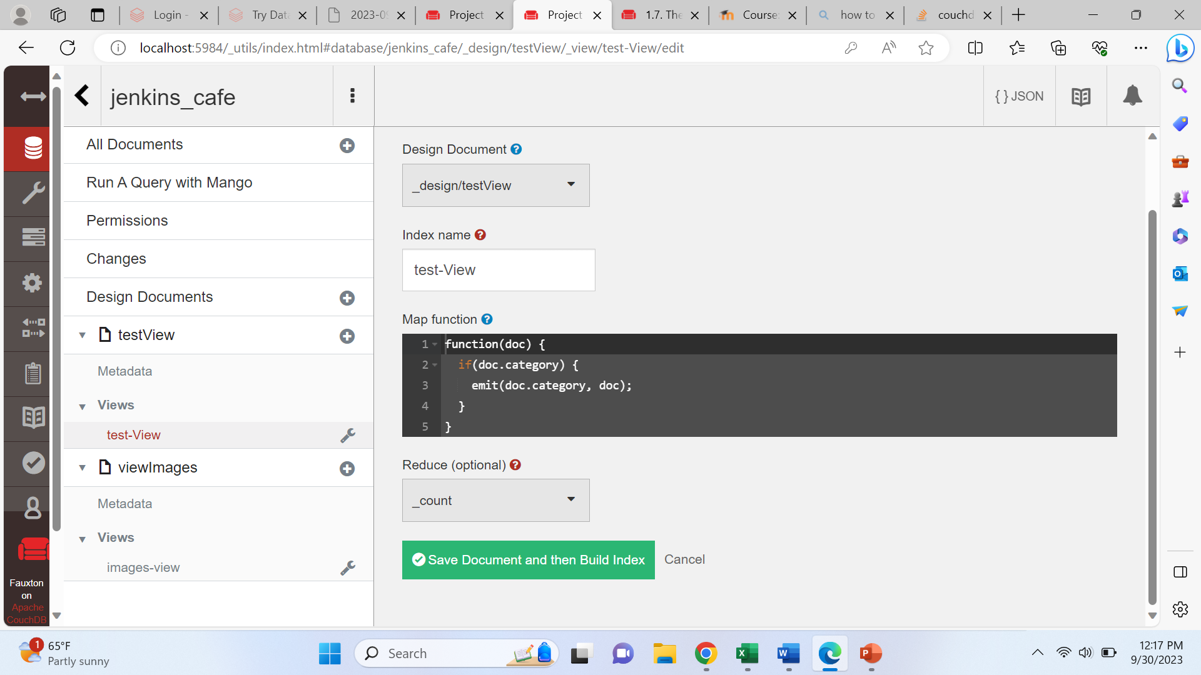
Apache CouchDB PRoject Code for Searching with the Reduce Function
12. From the Reduce (optional) drop-down box, click _Count (first figure).
13. Click the Save Document and Build Index button. Click Options (next to the Gears icon) and check the Reduce option to enable the Reduce function. Then, click Run Query to see the results.

Slide 9
Apache CouchDB Lab Adding Images to the Records
14. Click All Documents.Click the Table button to view data.
15. Now that you have created your database, query it through the map function to answer the following questions. Even though the data is small, the code should work with many records. Therefore, the target is to write successful code. Include a screenshot in this document showing all the data. Include screenshots of the code and output for each of the following map functions.
What is the count of records that have the column “Demand”? Write the code to which will display the answer. (Note: One way to answer this is to use code that displays all the records except those with the column Demand and then subtract the number from total number of records.)
Display the records with price more than 4.
Display the records from France.
Create a new view to answer another question of your choosing.

